Slide 1
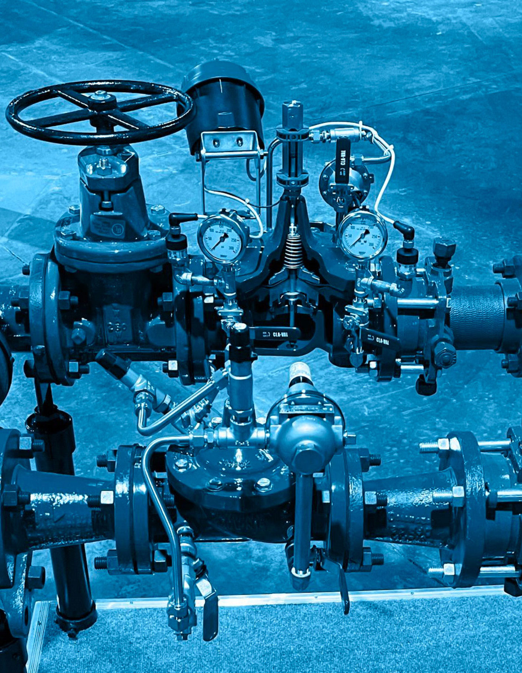
Design and Modifications in Pneumatic and Hydraulic Systems
Akbar Qamar
Mechatronics Engineering
Week 5
24/02/2025
1
Notes:
Briefly introduce yourself and the topic.
Mention that today’s class will cover the basics of pneumatic and hydraulic systems, design modifications, and a hands-on activity to build a 4-DOF arm kit.
24/02/2025
1

Slide 2
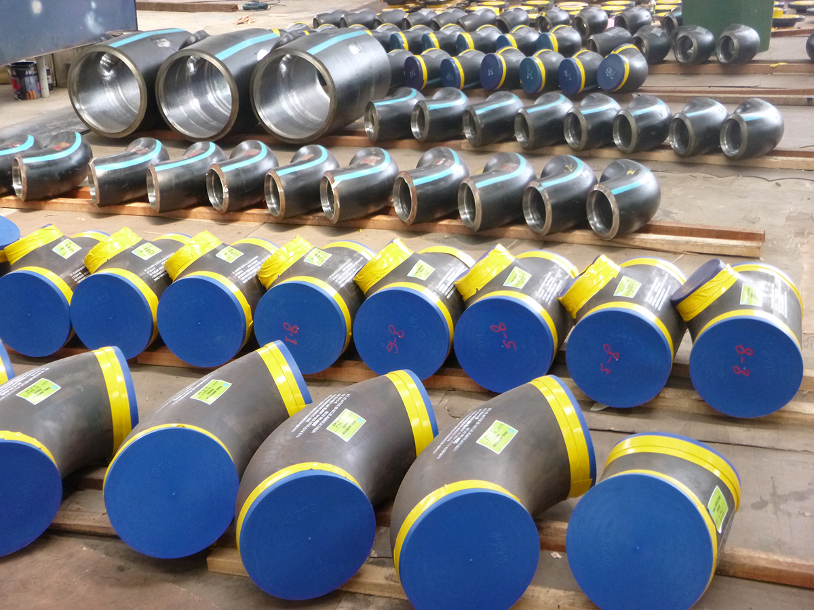
Agenda
Understand common components in pneumatic and hydraulic systems.
Learn how to evaluate and implement design modifications for improved functionality and reliability.
Apply knowledge to spec out and design a 4-DOF arm kit using syringe actuators and pumps.
Presentation Title
2/1/20XX
2
Notes:
Explain that by the end of the class, students will have a clear understanding of how pneumatic systems work, how to improve their designs, and how to apply this knowledge to a real-world project.
2
24/02/2025

Slide 3
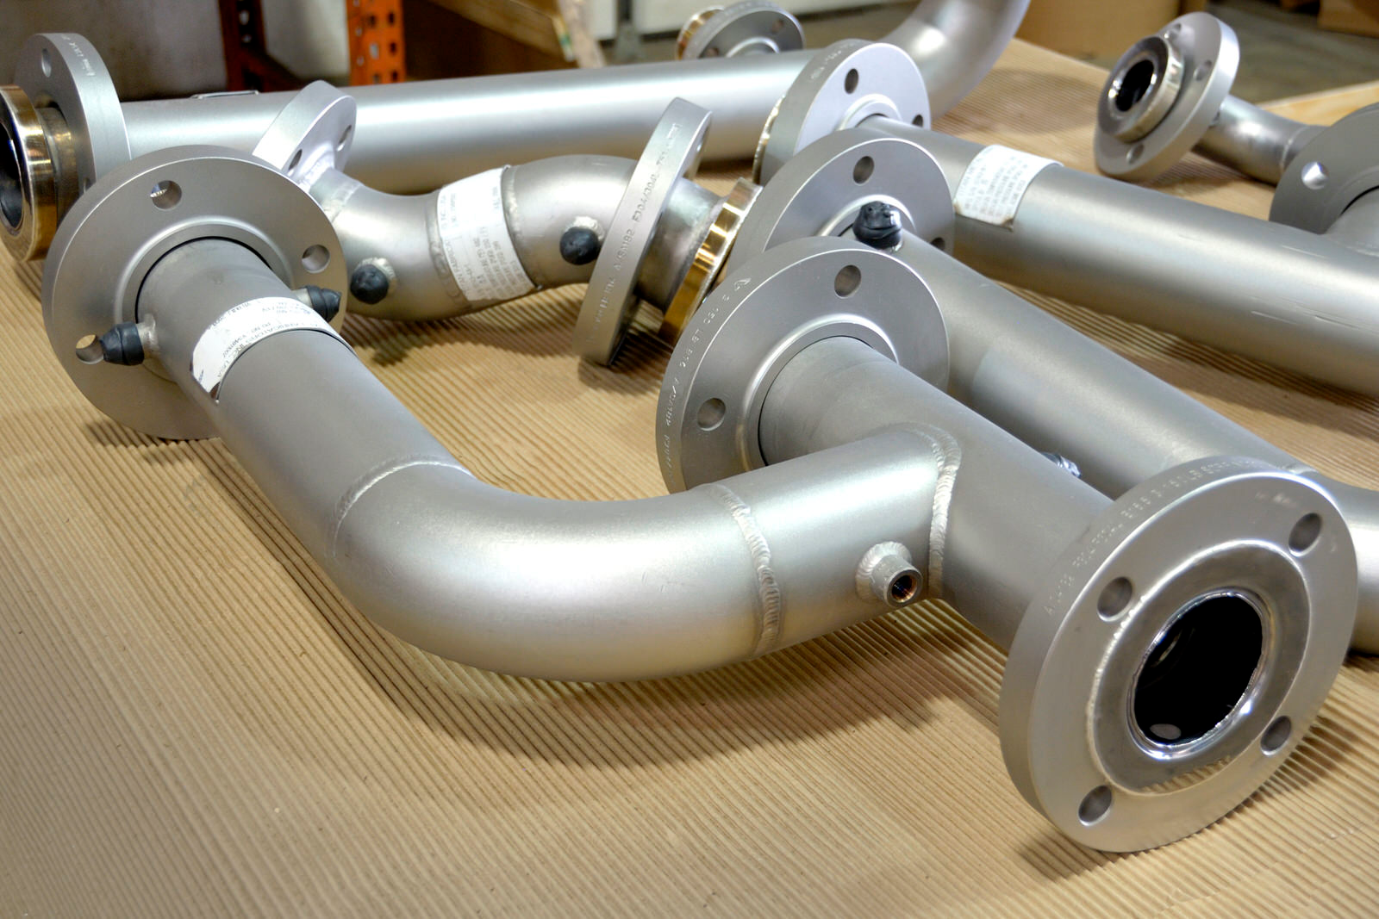
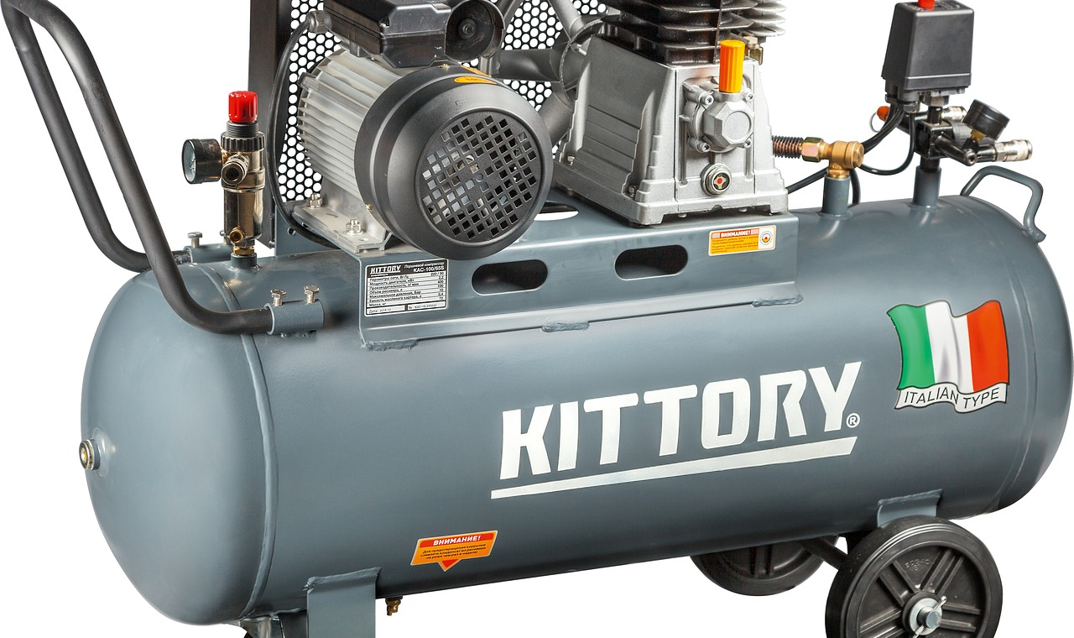
Common Components in Pneumatic/Hydraulic Systems
Valves: Control flow direction and pressure.
Compressors/Pumps: Generate pressure.
Actuators: Convert pressure into motion (e.g., linear actuators).
Tubing/Fittings: Connect components.
3
Notes:
Use analogies to make it relatable:
Valves are like traffic lights, controlling the flow of fluid/air.
Compressors/pumps are like the heart, providing the energy to move the system.
Actuators are like muscles, doing the physical work.
Tubing/fittings are like veins and arteries, connecting everything together.
3
24/02/2025

Slide 4
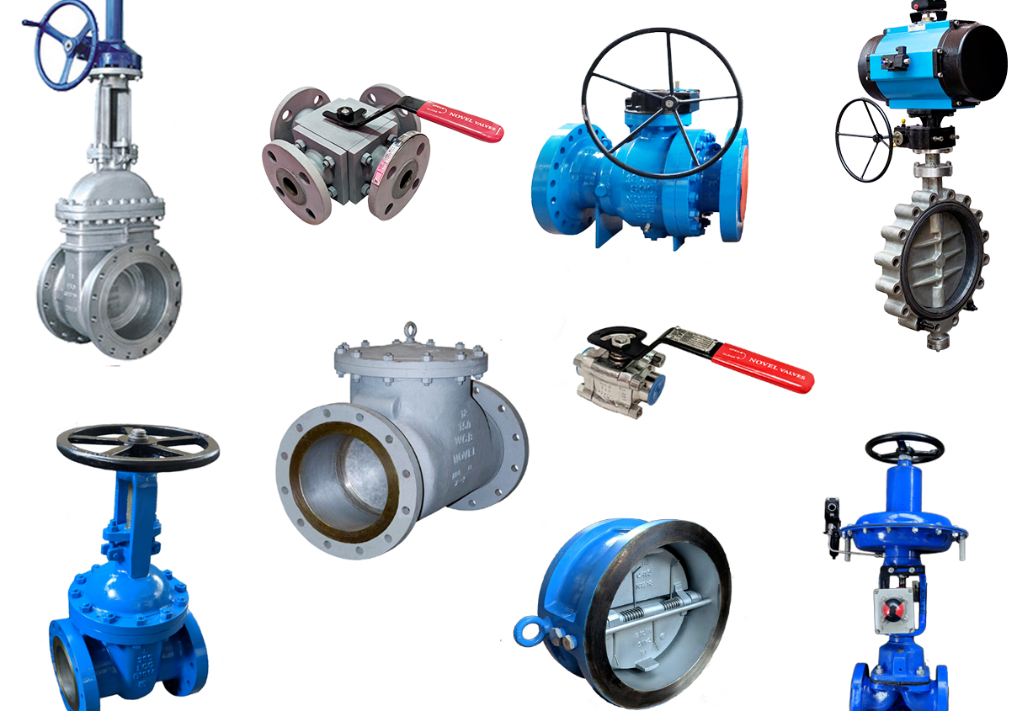
Valves
Direct fluid/air flow to control actuator movement.
Ensure safe operation by regulating pressure and flow.
Notes:
Explain the different types of valves and their specific roles.
Use diagrams to show how directional control valves work (e.g., how a 4-way valve controls a double-acting cylinder).
Discuss real-world examples (e.g., relief valves in hydraulic systems to prevent overpressure).
4
24/02/2025

Slide 5
Main Types of Valves
Directional Control Valves: Control the direction of flow (e.g., 2-way, 3-way, 4-way valves).
Pressure Control Valves: Regulate pressure (e.g., relief valves, pressure reducing valves).
Flow Control Valves: Adjust flow rate (e.g., throttle valves).
Presentation Title
2/1/20XX
5
Notes:
Explain the different types of valves and their specific roles.
Use diagrams to show how directional control valves work (e.g., how a 4-way valve controls a double-acting cylinder).
Discuss real-world examples (e.g., relief valves in hydraulic systems to prevent overpressure).
5
24/02/2025

Slide 6
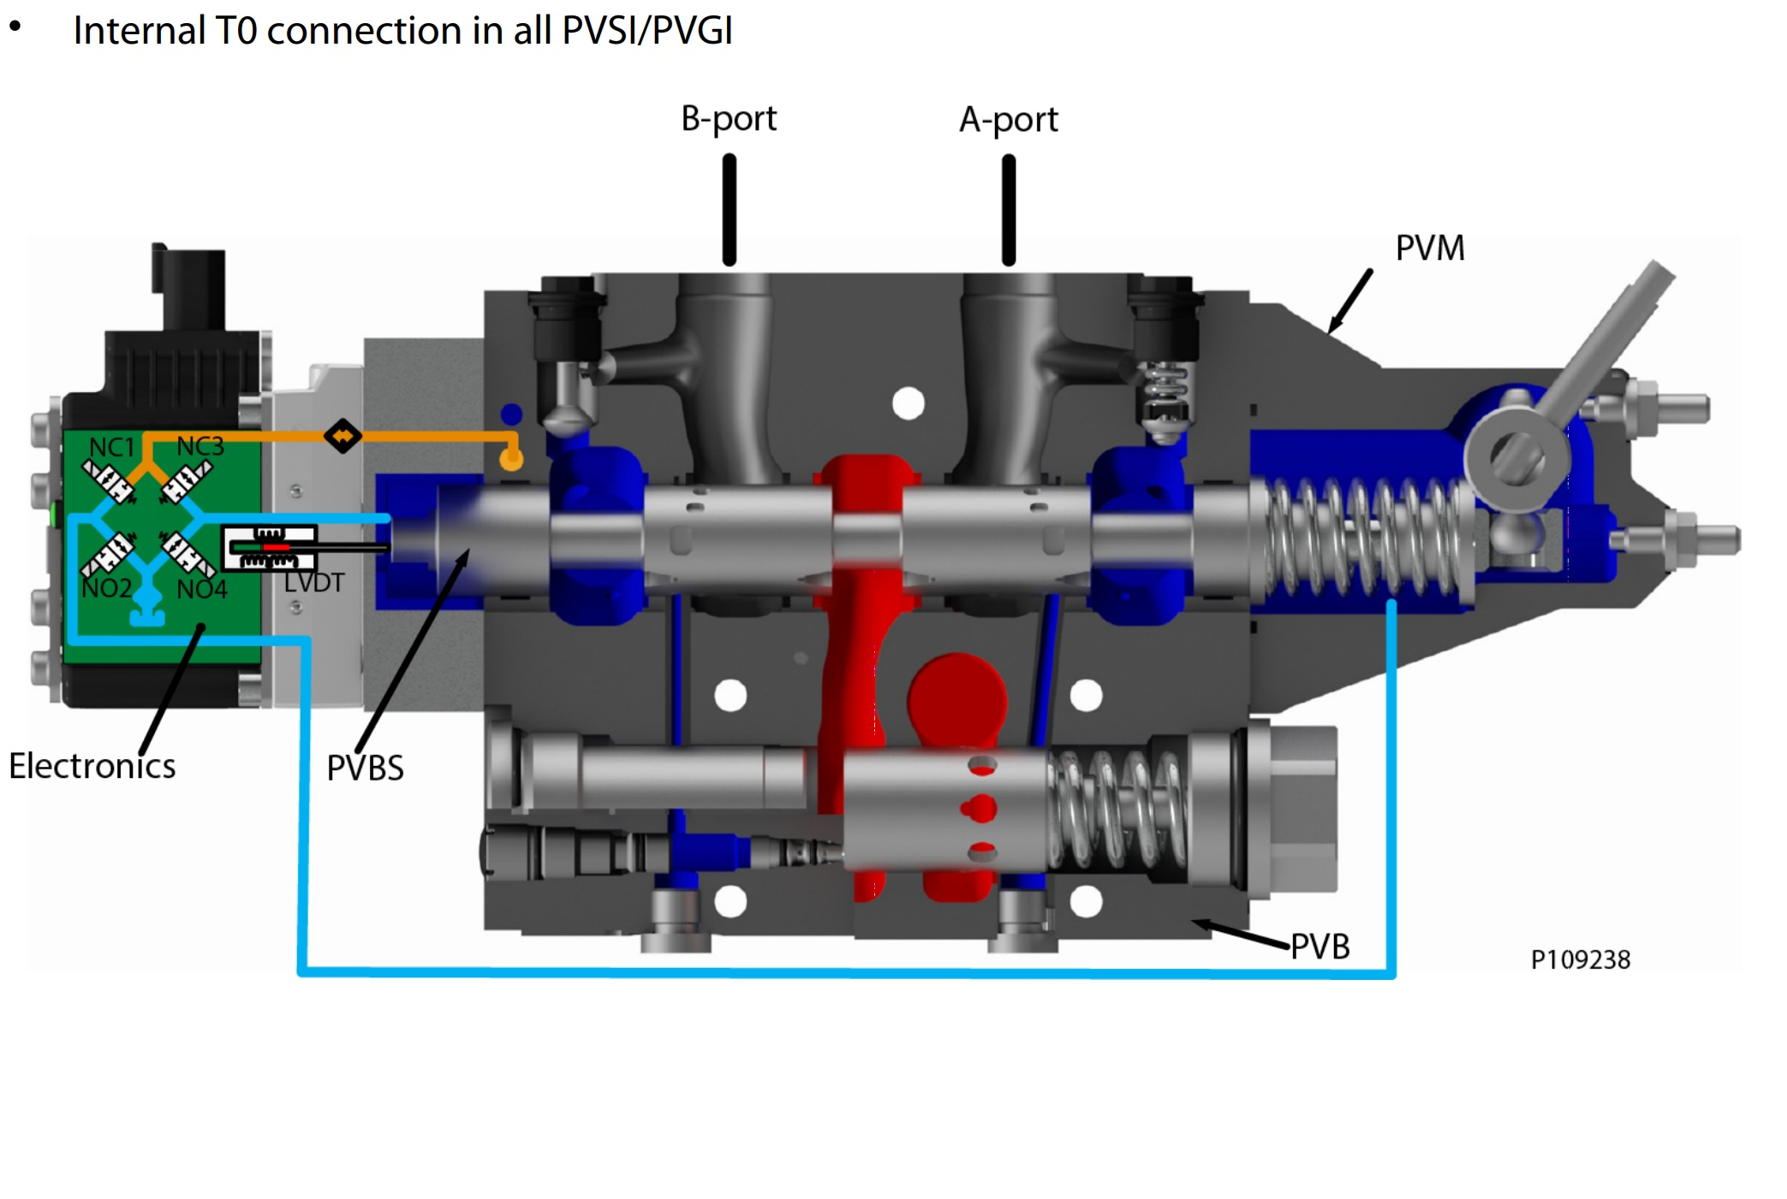
Directional
Image is an Electronically Controlled Valve
Notes:
6
24/02/2025

Slide 7
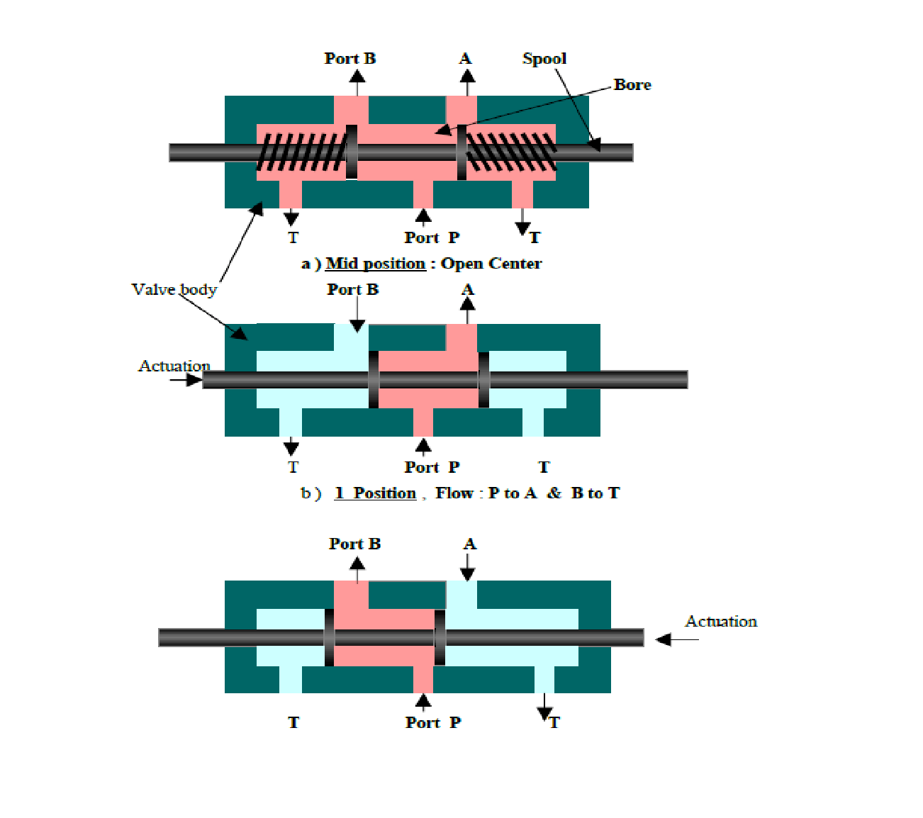
Directional
Image is an Electronically Controlled Valve Illustrated
Notes:
7
24/02/2025

Slide 8
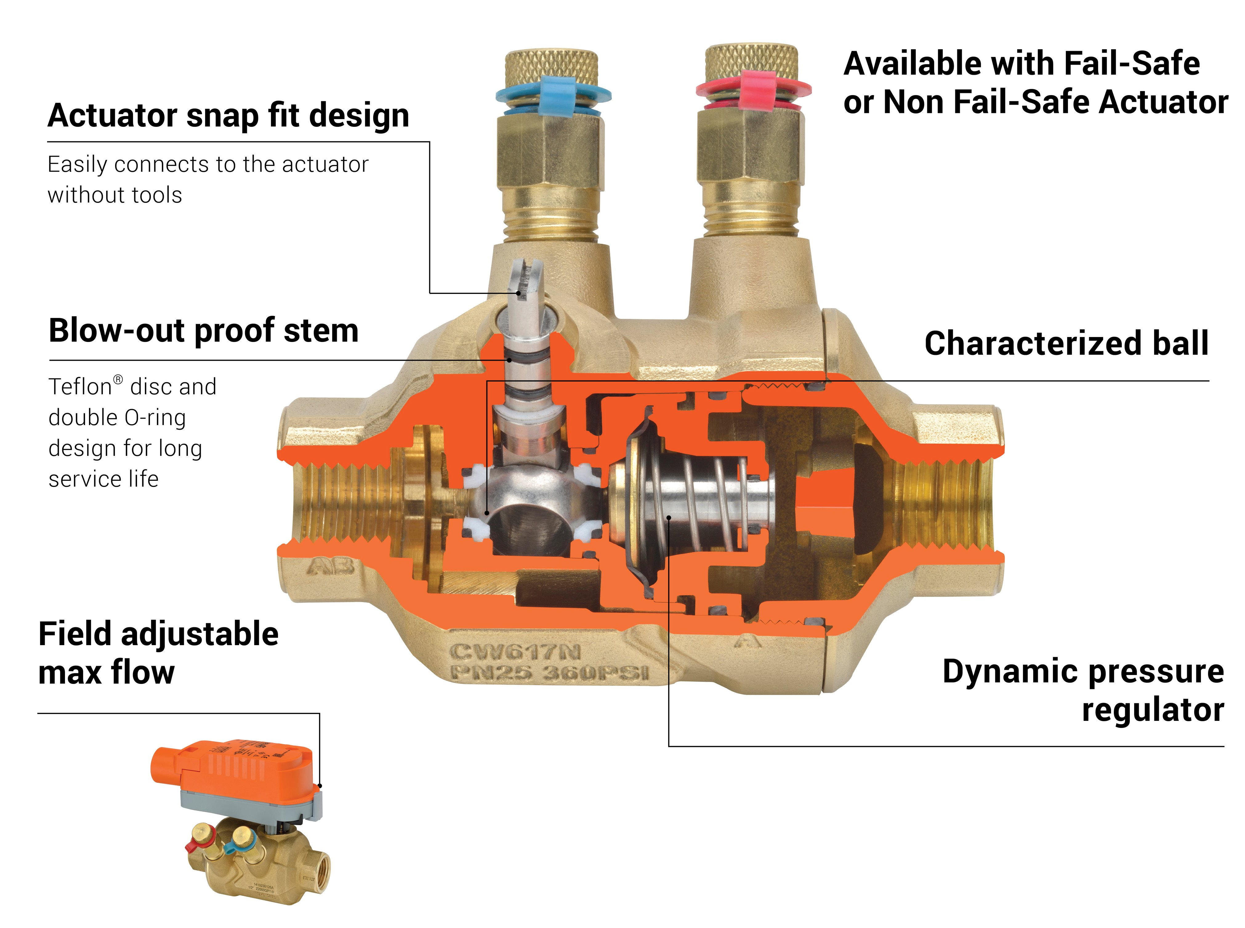
Regulator
Mechanical Spring Based Regulator
Notes:
8
24/02/2025

Slide 9
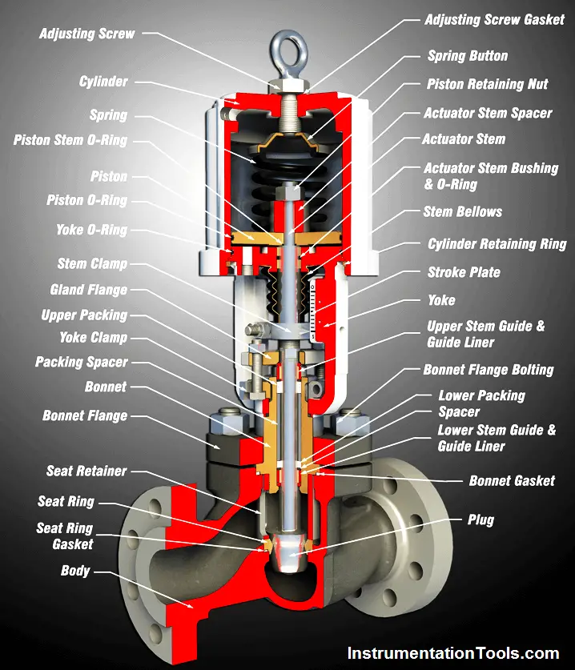
Regulator
Mechanical Spring Based Regulator, Adjustable
Notes:
9
24/02/2025

Slide 10
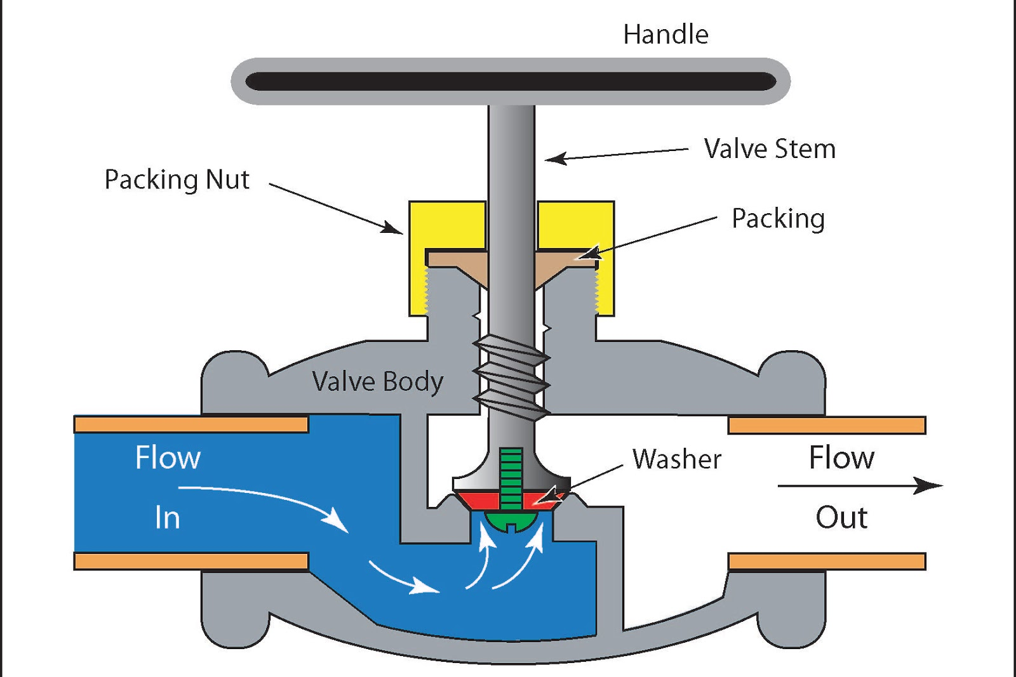
Flow
Controls the Volume Flow
Notes:
10
24/02/2025

Slide 11
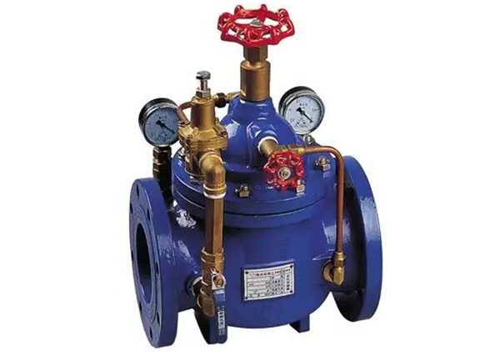
Flow
Controls the Volume Flow
Notes:
11
24/02/2025

Slide 12
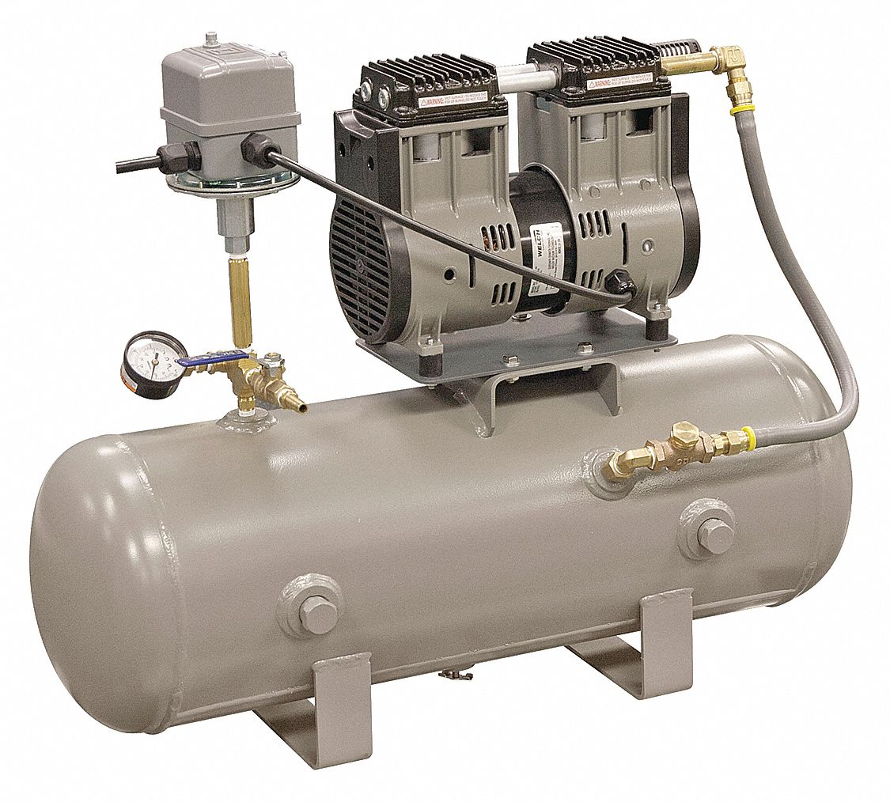
Compressors and Pumps
Generate pressure to move fluid/air through the system.
Provide the energy needed for actuators to perform work.
Notes:
Explain the differences between compressors (for pneumatics) and pumps (for hydraulics).
Discuss the pros and cons of each type (e.g., reciprocating compressors are compact but noisy, rotary screw compressors are quieter but more expensive).
Use diagrams to show how each type works.
12
24/02/2025

Slide 13
Types of Compressors (Pneumatics):
  Reciprocating Compressors: Use pistons to compress air.
  Rotary Screw Compressors: Use rotating screws for continuous air supply.
Presentation Title
2/1/20XX
13
Notes:
Explain the differences between compressors (for pneumatics) and pumps (for hydraulics).
Discuss the pros and cons of each type (e.g., reciprocating compressors are compact but noisy, rotary screw compressors are quieter but more expensive).
Use diagrams to show how each type works.
13
24/02/2025

Slide 14
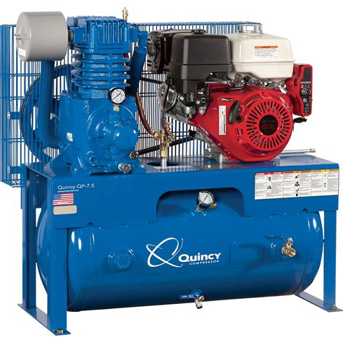
Compressor
Image is a Traditional Compressor You Find in Day to Day Life
Notes:
14
24/02/2025

Slide 15
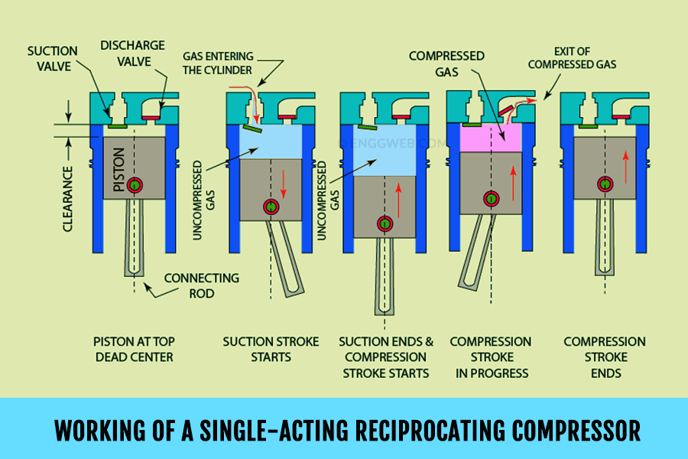
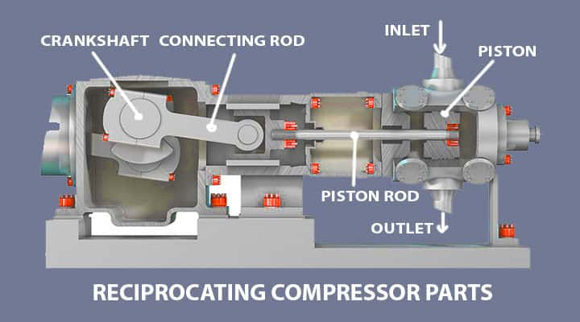
Directional
Image is an Electronically Controlled Valve
Notes:
15
24/02/2025

Slide 16
Directional
Image is an Electronically Controlled Valve
Notes:
16
24/02/2025

Slide 17
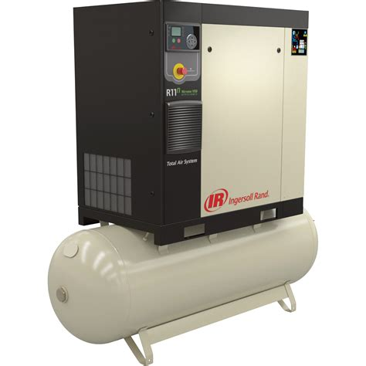
Compressor
Rotary Screw is Not as Common
Notes:
17
24/02/2025

Slide 18
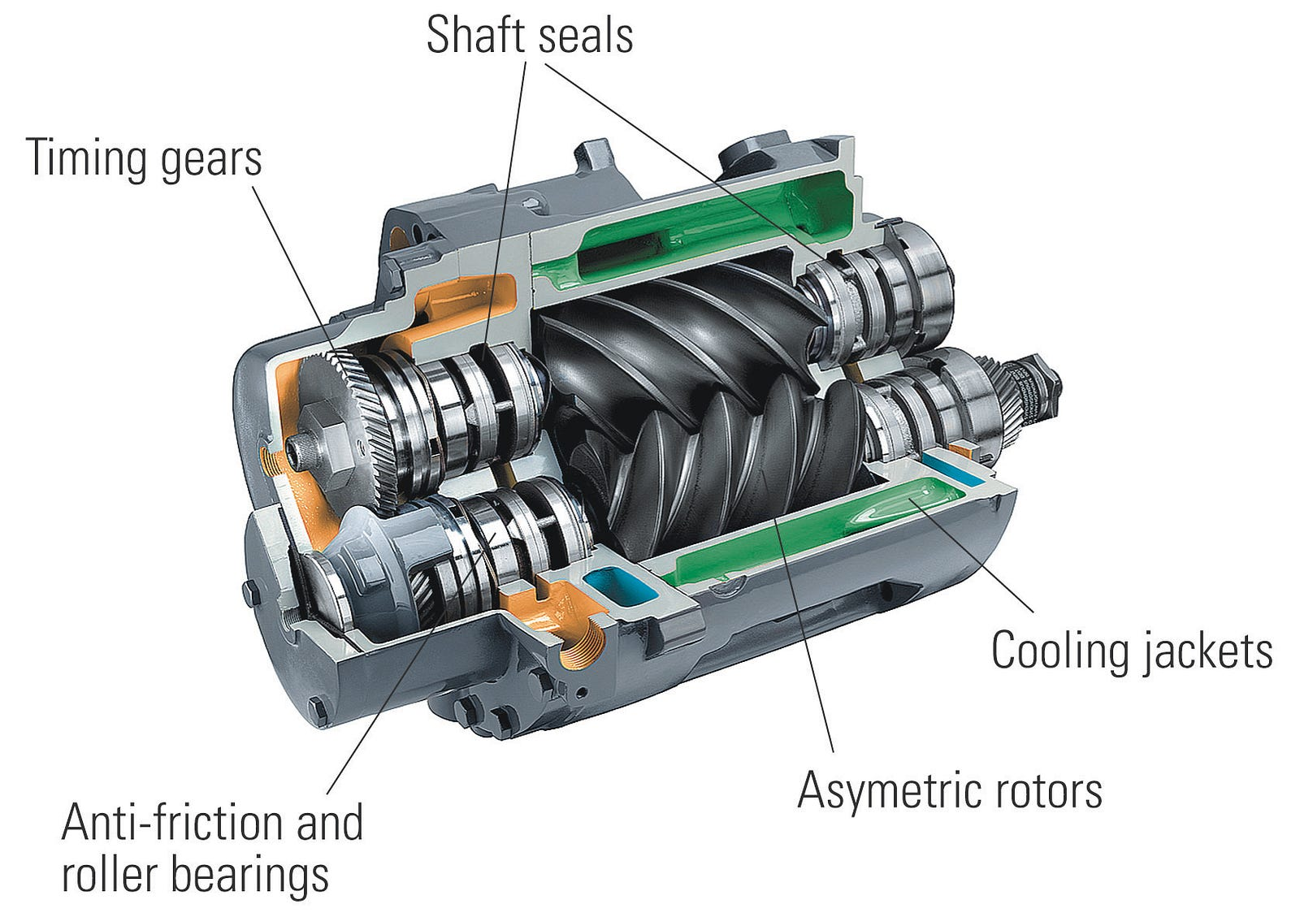
Notes:
18
24/02/2025

Slide 19
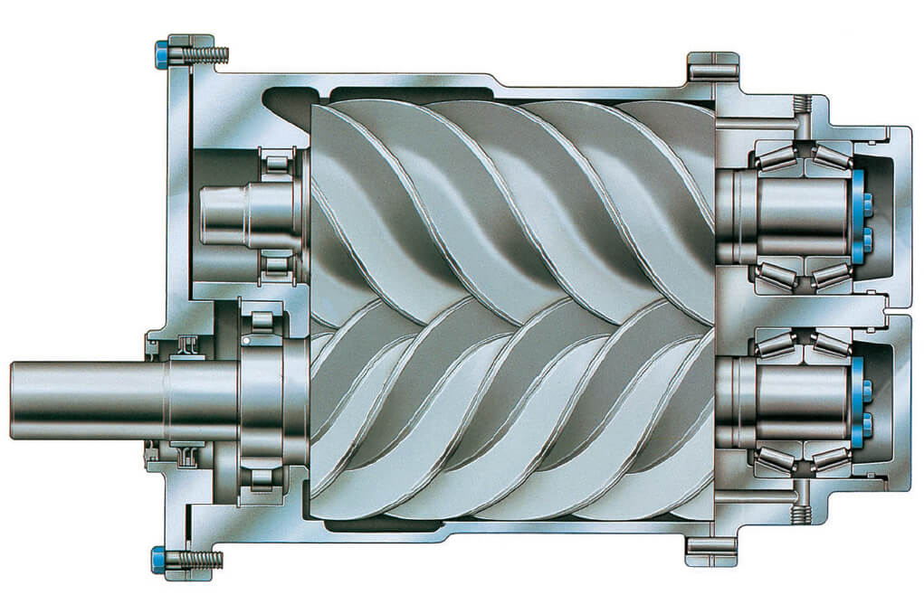
Notes:
19
24/02/2025

Slide 20
Rotary Screw Compressor vs. Reciprocating Compressor
Reciprocating Compressor:
  Uses pistons to compress air.
  Intermittent operation (on/off cycling).
  Compact and cost-effective for small-scale applications.
Rotary Screw Compressor:
  Uses rotating screws to compress air.
  Continuous operation with steady airflow.
  Higher initial cost but more efficient for large-scale or continuous-use applications.
Presentation Title
2/1/20XX
20
Notes:
Explain the basic working principles of both types.
Highlight the key differences in operation, efficiency, and cost.
20
24/02/2025

Slide 21
Advantages of Rotary Screw Compressors
1. Continuous Operation:
  Provides a steady flow of compressed air without pulsations.
  Ideal for applications requiring constant air supply (e.g., manufacturing lines).
2. Higher Efficiency:
  Lower energy consumption per unit of air produced.
  Better suited for high-demand applications.
Presentation Title
2/1/20XX
21
Notes:
Explain the basic working principles of both types.
Highlight the key differences in operation, efficiency, and cost.
21
24/02/2025

Slide 22
Advantages of Rotary Screw Compressors
3. Lower Maintenance:
  Fewer moving parts compared to reciprocating compressors.
  Longer lifespan and reduced downtime.
4. Quieter Operation:
  Rotary screw compressors operate more quietly than reciprocating compressors.
  Better for environments where noise is a concern.
5. Compact Design:
  Despite higher capacity, rotary screw compressors often have a smaller footprint than reciprocating compressors of similar output.
Presentation Title
2/1/20XX
22
Notes:
Discuss each advantage in detail.
Use real-world examples to illustrate where rotary screw compressors are preferred (e.g., large factories, automotive assembly lines).
22
24/02/2025

Slide 23
Disadvantages of Rotary Screw Compressors
1. Higher Initial Cost:
  More expensive to purchase and install compared to reciprocating compressors.
2. Complexity:
  More complex design, requiring specialized maintenance and expertise.
3. Less Suitable for Intermittent Use:
  Designed for continuous operation, making them less efficient for applications with sporadic air demand.
Presentation Title
2/1/20XX
23
Notes:
Explain why these disadvantages might make rotary screw compressors less suitable for certain applications (e.g., small workshops with low air demand).
23
24/02/2025

Slide 24
Advantages of Reciprocating Compressors
1. Lower Initial Cost:
  More affordable for small-scale or low-budget applications.
2. Simple Design:
  Easier to maintain and repair.
3. Suitable for Intermittent Use:
  Ideal for applications with sporadic air demand (e.g., small workshops, DIY projects).
Presentation Title
2/1/20XX
24
Notes:
Highlight scenarios where reciprocating compressors are a better choice.
Use examples like small garages or home workshops.
24
24/02/2025

Slide 25
Disadvantages of Reciprocating Compressors
1. Pulsating Airflow:
  Produces uneven airflow, which can affect certain applications.
2. Higher Maintenance:
  More moving parts (e.g., pistons, valves) lead to more wear and tear.
3. Noisy Operation:
  Louder than rotary screw compressors, which can be a drawback in noise-sensitive environments.
4. Limited Capacity:
  Less efficient for high-demand or continuous-use applications.
Presentation Title
2/1/20XX
25
Notes:
Discuss how these disadvantages make reciprocating compressors less suitable for large-scale or continuous-use applications.
25
24/02/2025

Slide 26
Summary of Key Differences
Rotary Screw Compressor:
  Continuous operation, higher efficiency, quieter, higher initial cost.
Reciprocating Compressor:
  Intermittent operation, lower initial cost, simpler design, noisier.
Presentation Title
2/1/20XX
26
Notes:
Discuss how these disadvantages make reciprocating compressors less suitable for large-scale or continuous-use applications.
26
24/02/2025

Slide 27
Types of Compressors (Hydraulics):
Gear Pumps: Simple and reliable for low-pressure systems.
Piston Pumps: High-pressure and high-efficiency for heavy-duty applications.
Presentation Title
2/1/20XX
27
Notes:
Explain the differences between compressors (for pneumatics) and pumps (for hydraulics).
Discuss the pros and cons of each type (e.g., reciprocating compressors are compact but noisy, rotary screw compressors are quieter but more expensive).
Use diagrams to show how each type works.
27
24/02/2025

Slide 28
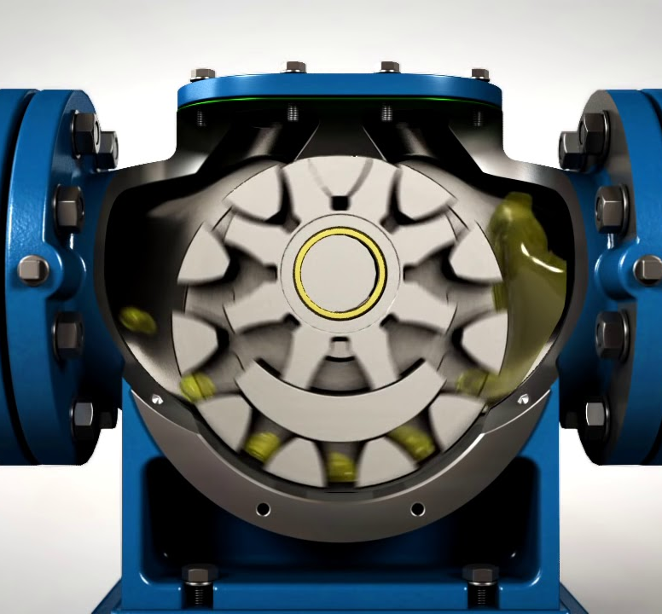
Gear
Uses Teeth to Generate Centrifugal Force
Notes:
28
24/02/2025

Slide 29
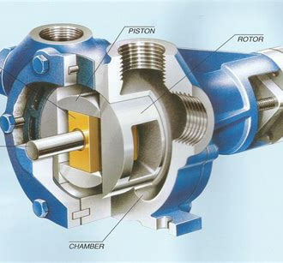
Piston
Uses a piston to push and pull controlling flow via one-way valves
Notes:
29
24/02/2025

Slide 30
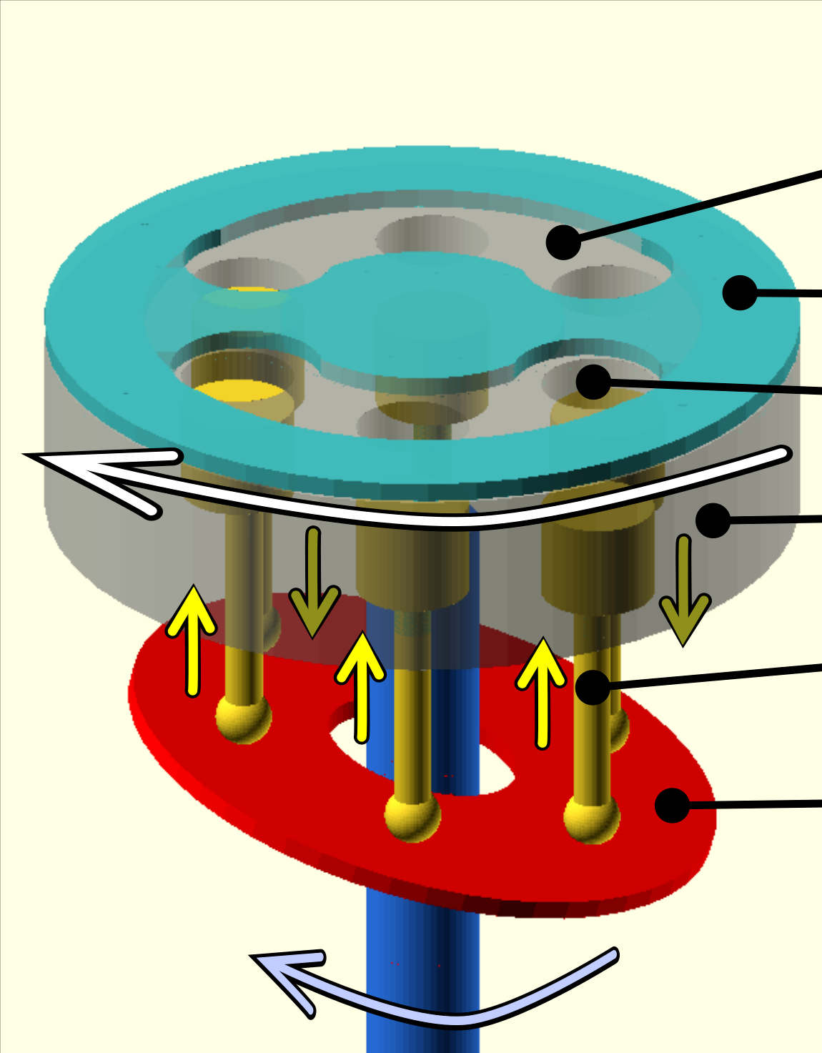
Piston
Uses a piston to push and pull controlling flow via one-way valves
Notes:
30
24/02/2025

Slide 31
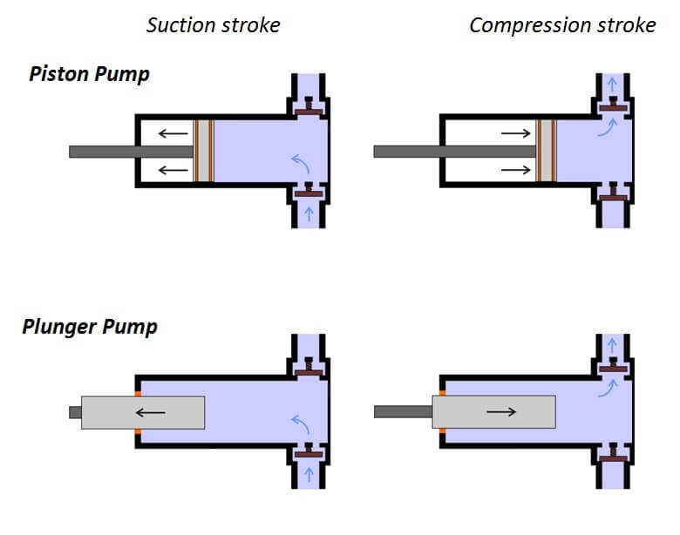
Piston
Uses a piston to push and pull controlling flow via one-way valves
Notes:
31
24/02/2025

Slide 32
Gear vs Piston Pump
Gear Pump:
Pros: Simple, low cost, reliable, and compact.
Cons: Limited to low-pressure applications, noisy, and less efficient.
Best for: Low-pressure systems like lubrication or fuel transfer.
Piston Pump:
Pros: Handles very high pressures, highly efficient, and quiet.
Cons: Expensive, complex, and requires more maintenance.
Best for: High-pressure systems like construction equipment or aerospace hydraulics.
Presentation Title
2/1/20XX
32
Notes:
Explain the basic working principles of both types.
Highlight the key differences in operation, efficiency, and cost.
32
24/02/2025

Slide 33
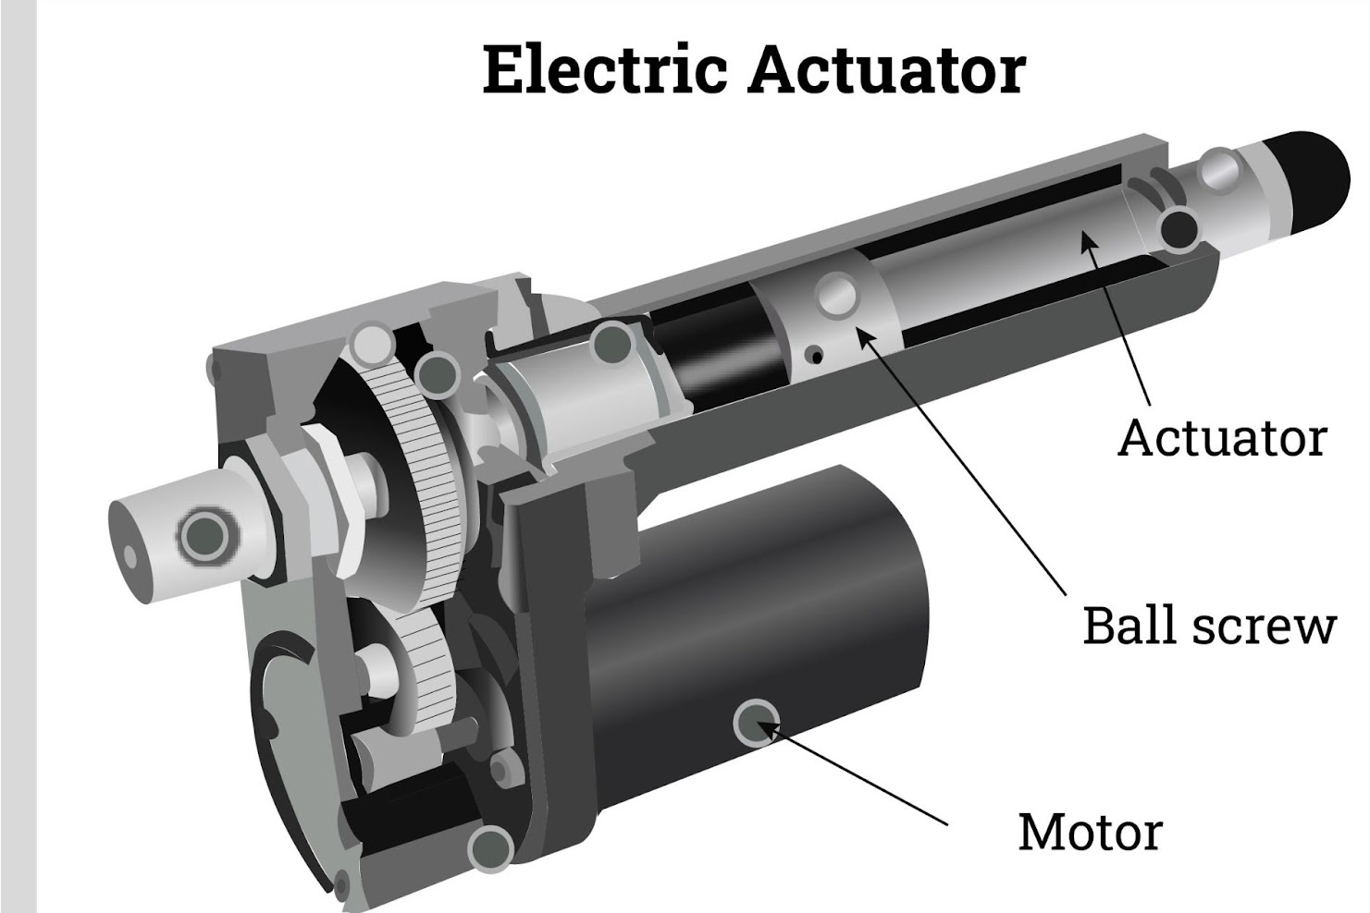
Actuators
Perform the physical work (e.g., lifting, pushing, rotating).
Translate fluid/air pressure into mechanical motion.
Notes:
33
24/02/2025

Slide 34
Types of Actuators:
  Linear Actuators: Convert pressure into linear motion (e.g., hydraulic cylinders, pneumatic pistons).
  Rotary Actuators: Convert pressure into rotational motion (e.g., hydraulic motors, pneumatic rotary actuators).
Presentation Title
2/1/20XX
34
Notes:
Explain the difference between linear and rotary actuators.
Use examples to show their applications (e.g., hydraulic cylinders in excavators, pneumatic pistons in assembly lines).
Discuss how actuators are selected based on force, speed, and precision requirements.
34
24/02/2025

Slide 35
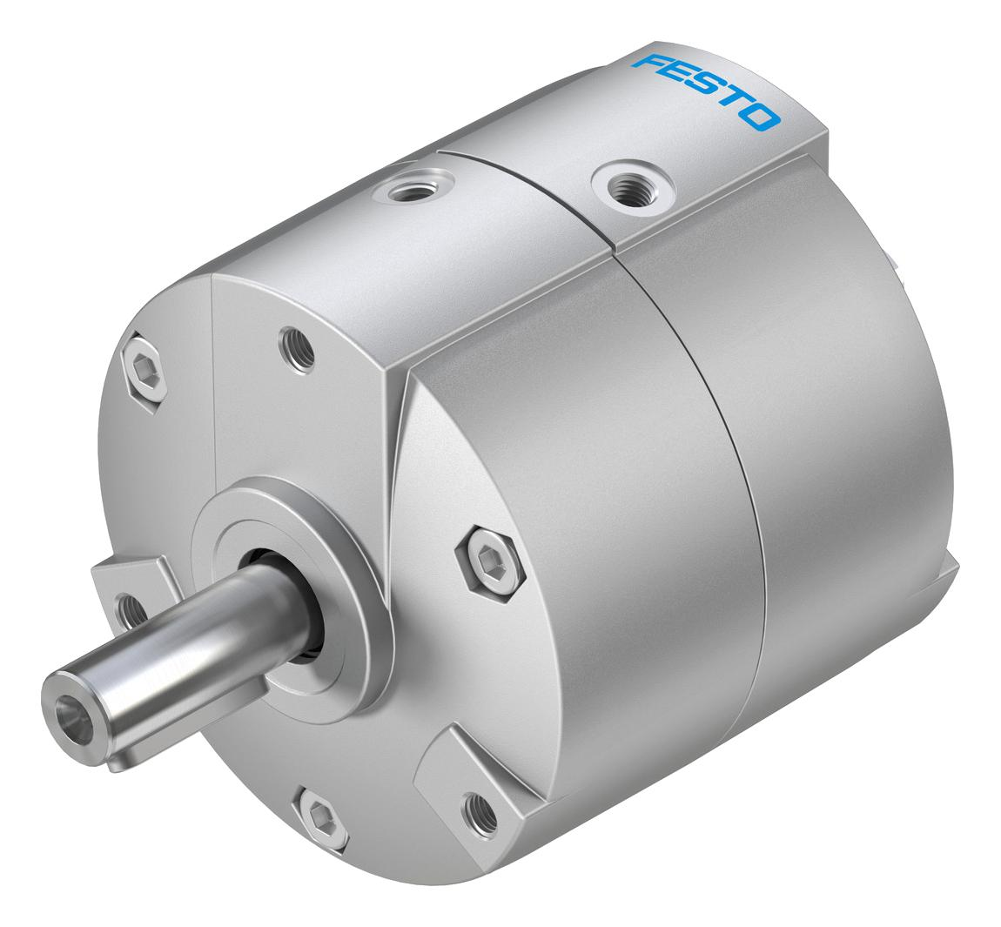
Rotatory
Notes:
35
24/02/2025

Slide 36
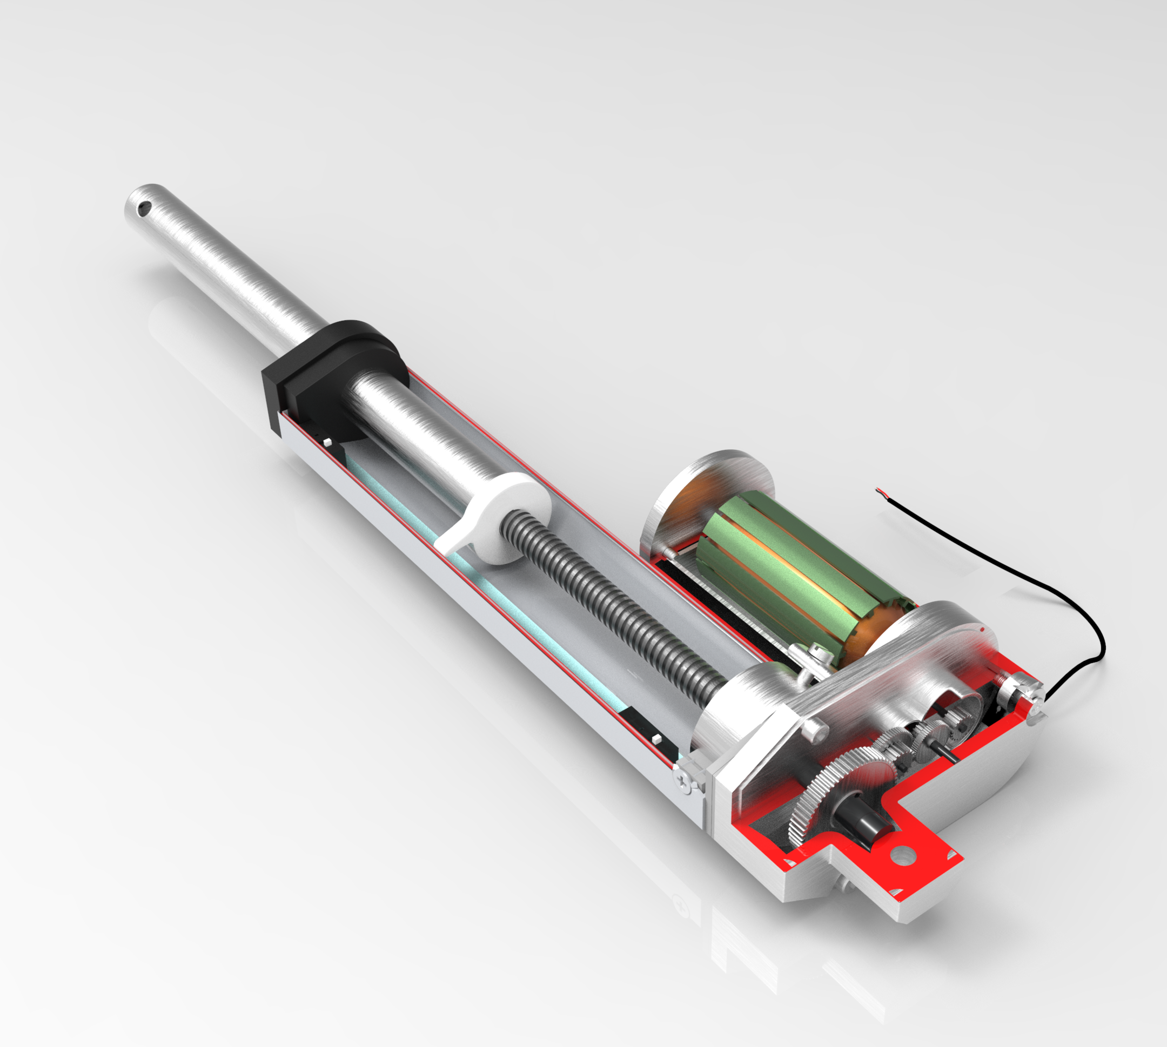
Linear
Notes:
Explain the difference between linear and rotary actuators.
Use examples to show their applications (e.g., hydraulic cylinders in excavators, pneumatic pistons in assembly lines).
Discuss how actuators are selected based on force, speed, and precision requirements.
36
24/02/2025

Slide 37
Actuators
Perform the physical work (e.g., lifting, pushing, rotating).
Translate fluid/air pressure into mechanical motion.
Notes:
37
24/02/2025

Slide 38
Tubing and Fittings
Types of Tubing:
  Pneumatic Tubing: Typically made of nylon or polyurethane for flexibility and durability.
  Hydraulic Tubing: Made of steel or high-pressure hose for strength and leak resistance.
Presentation Title
2/1/20XX
38
Notes:
Explain the difference between linear and rotary actuators.
Use examples to show their applications (e.g., hydraulic cylinders in excavators, pneumatic pistons in assembly lines).
Discuss how actuators are selected based on force, speed, and precision requirements.
38
24/02/2025

Slide 39
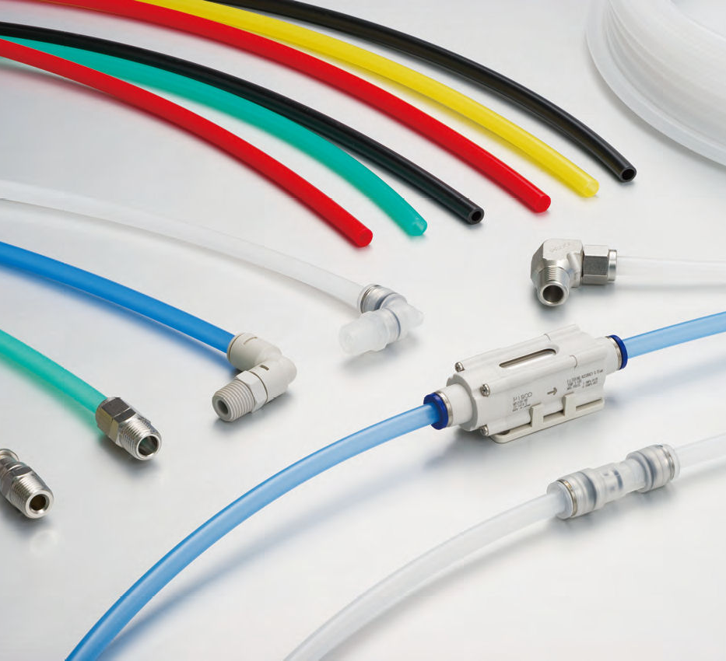
Material Depends on the Pressure it needs to Withstand
Notes:
39
24/02/2025

Slide 40
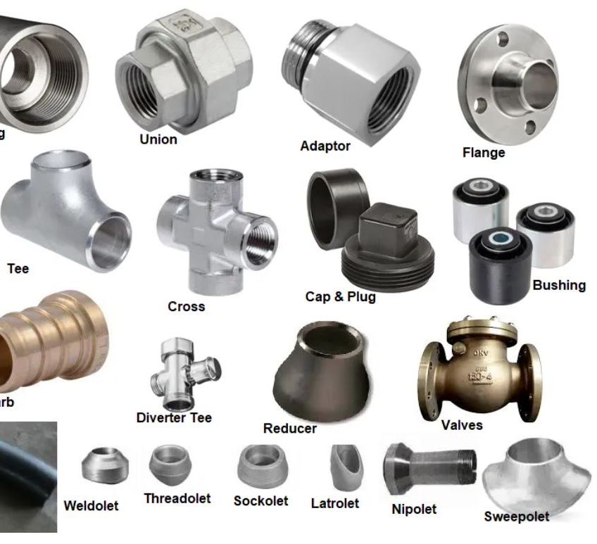
Connect components to ensure fluid/air flows smoothly through the system.
Prevent leaks and maintain system pressure.
Notes:
40
24/02/2025

Slide 41
Types of Fittings:
Quick-Connect Fittings: Allow for easy assembly and disassembly.
Threaded Fittings: Provide secure, leak-free connections.
Presentation Title
2/1/20XX
41
Notes:
Explain the difference between linear and rotary actuators.
Use examples to show their applications (e.g., hydraulic cylinders in excavators, pneumatic pistons in assembly lines).
Discuss how actuators are selected based on force, speed, and precision requirements.
41
24/02/2025

Slide 42
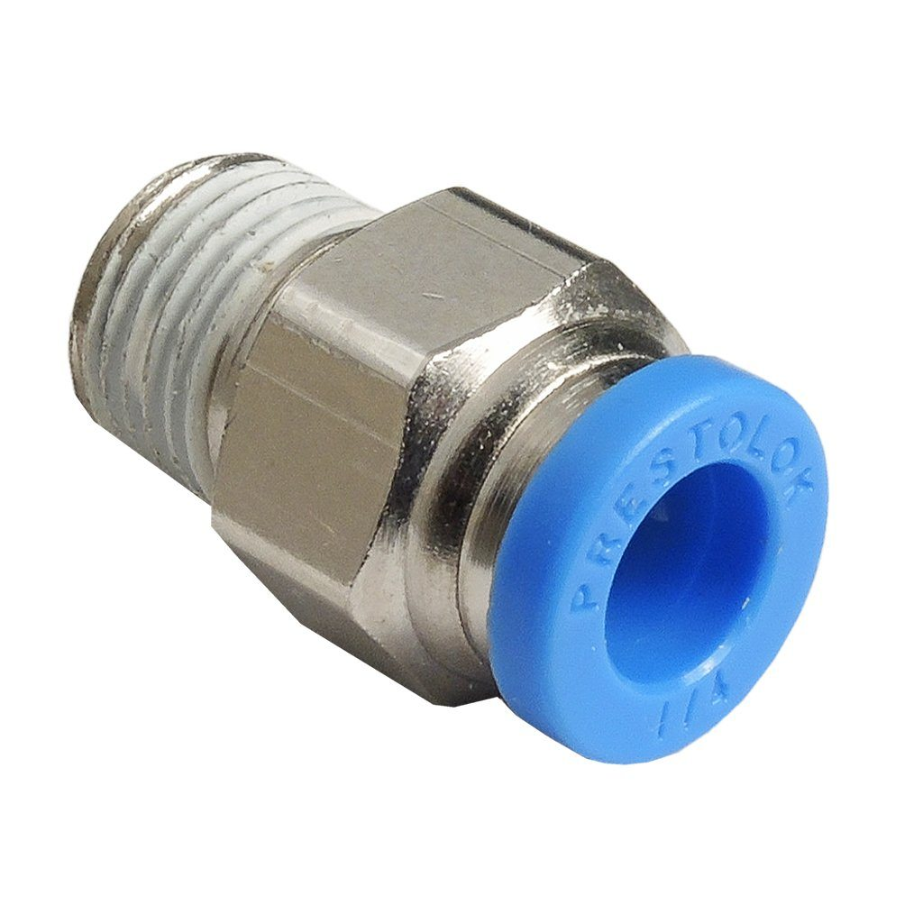
Easy to Add and Remove
More Expensive
Notes:
42
24/02/2025

Slide 43
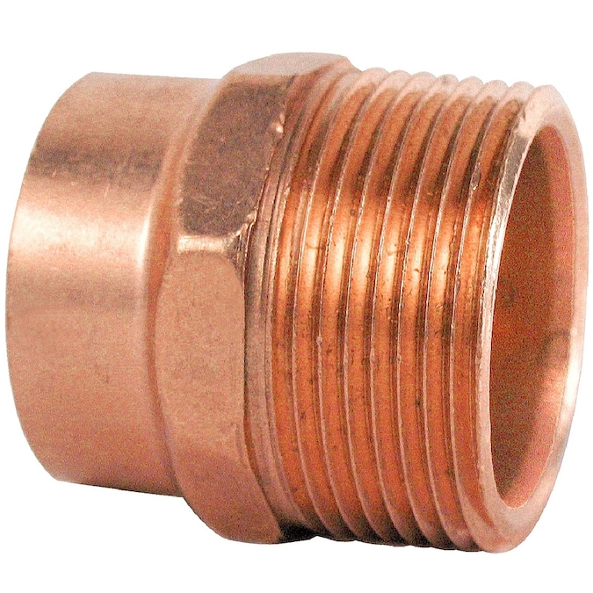
Hard to Install
Cheaper
Notes:
43
24/02/2025

Slide 44
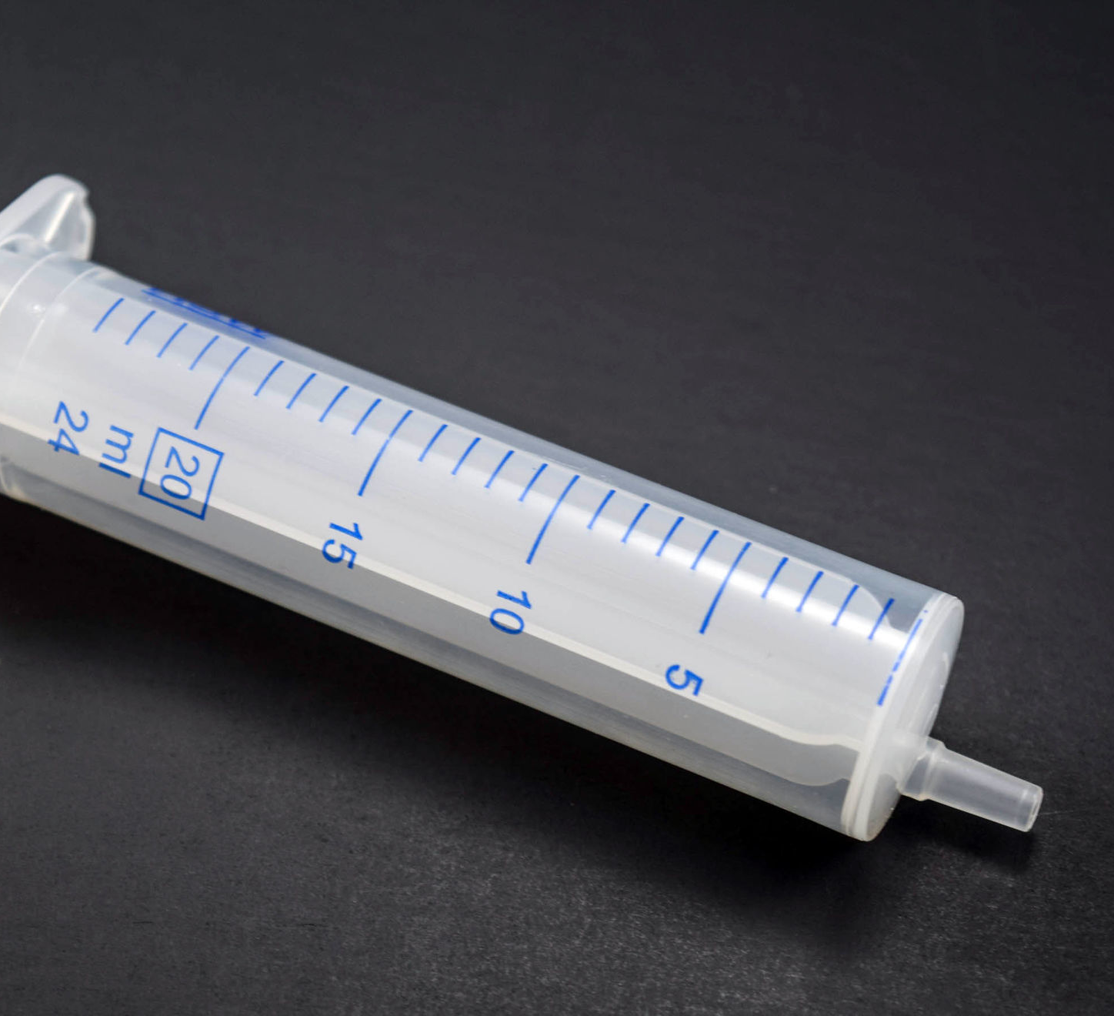
Why Use Syringes in Our Design?
Notes:
44
24/02/2025

Slide 45
Advantages:
Simple and cost-effective.
Easy to control manually or with pumps.
Provide precise linear motion.
Applications: Ideal for small-scale systems like the arm kit.
Presentation Title
2/1/20XX
45
Notes:
Explain why syringes are a good choice for this project.
Discuss how they compare to other types of actuators.
45
24/02/2025

Slide 46
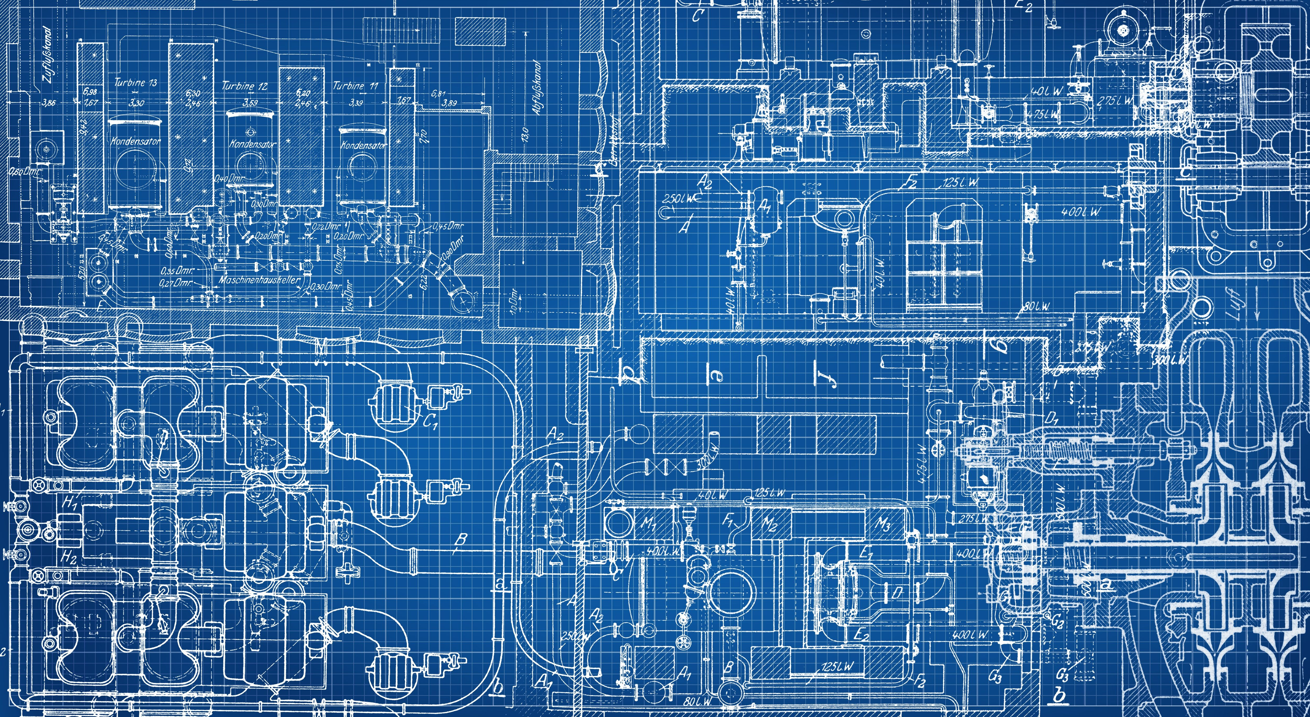
Activity:
Design and Spec Out the System
25 Feb 2025
46
Notes:
46
24/02/2025

Slide 47

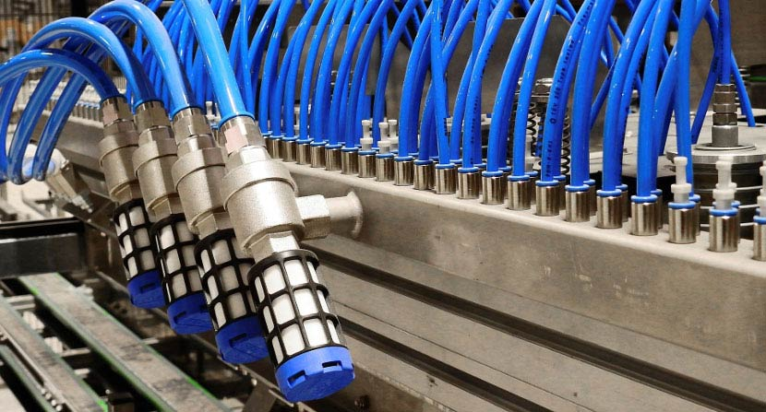
THANK YOU
Akbar Qamar
Mechatronics Engineering
47
Notes:
47
24/02/2025

